Slide 1
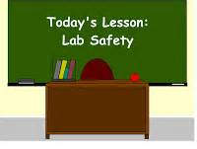
Science Lab Safety Rap with Lyrics http://youtu.be/qqI1gafJA-4a

Slide 2
KEY WORDS
hazard symbols Simboli di pericolo
health hazards Rischi per la salute
physical hazards Pericoli fisici
pipetting device Dispositivo di pipettaggio
Bunsen burners Becchi di Bunsen
Pipette Pipetta
Glassware Vetreria
Banch tops Parti superiori del banco di lavoro

Slide 3
KEY WORDS
Aprons Grembiuli
Lab coat Camice
Burners Bruciatore, becco a gas
Water faucets Rubinetti dell'acqua
Gas valves Valvole del gas
Sink Lavello
Test tubes Provette
Safety panel Pannello di sicurezza
Fire extinguisher Estintore

Slide 4
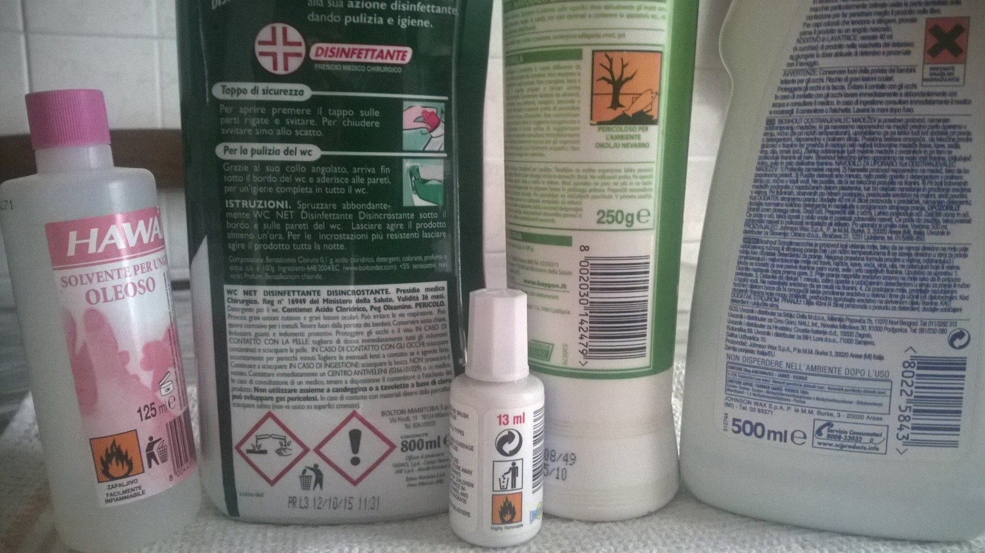
hazard symbols at home

Slide 5
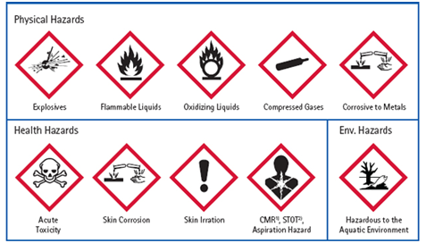
Hazard symbols

Slide 6
Homework
look for products you use with these symbols
Take a photo
Put it in the virtual classroom

Slide 7
What are the rules to observe in a laboratory
Students should be carefully informed of the correct way to act in the laboratory and constantly aware that their incorrect behaviour may cause serious damages both to themselves and to the others

Slide 8
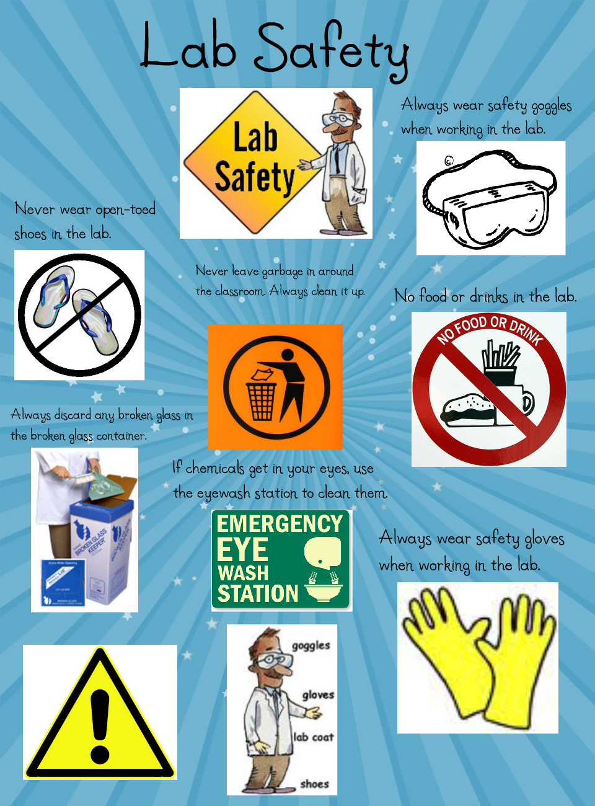
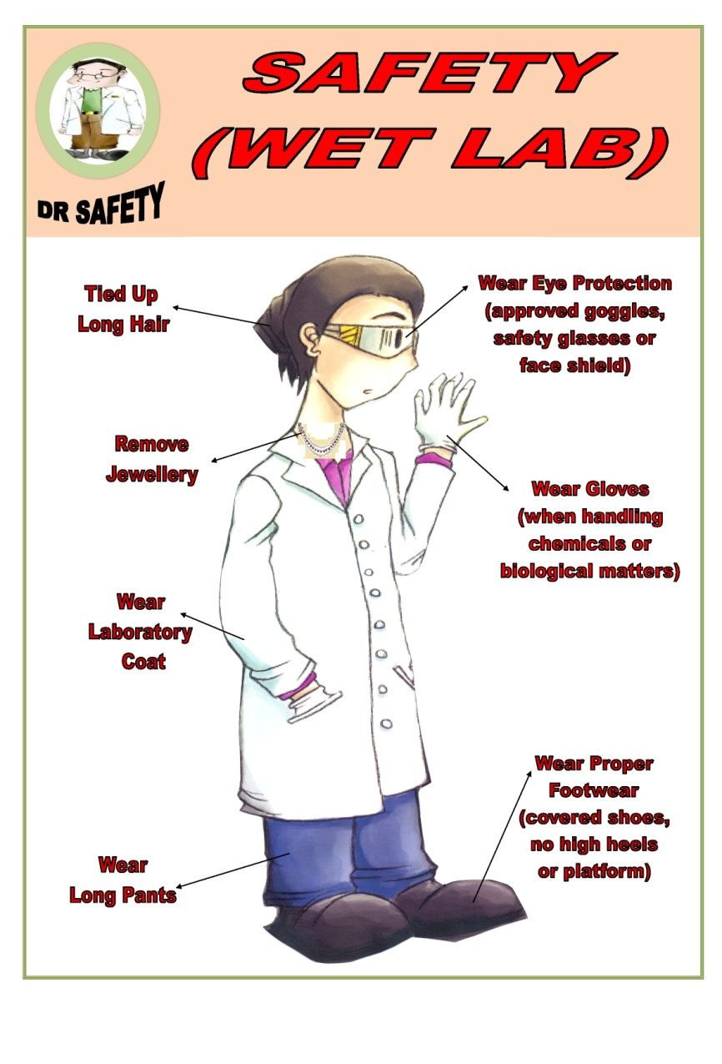
Some rules Clothing

Slide 9

Science Lab Safety Rap with Lyrics http://youtu.be/qqI1gafJA-4a

Slide 10
DON’Ts
Never run or engage in practical jokes
Don’t leave your personal items (coats, books, etc.) on the bench tops or on the floor
The performance of unauthorized experiments is strictly forbidden
Don’t sit on benches or desks
Smoking, drinking and eating are forbidden
Never fill a pipette using mouth suction. Always use a pipetting device
Don’t leave Bunsen burners unattended
Don’t wash glassware in cold water when it’s hot
Don’t wear your hair loose (if long)

Slide 11
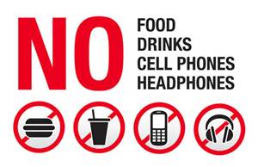
DON’Ts

Slide 12
DOs
Always wear shoes and lab coats while entering the lab
Use gloves, aprons,glasses and caps while handling concentrated or dangerous solutions
Keep substances stored in their proper cabinets
Keep the test tube in slanting position away from the face while using it
Use test tube holders while heating or adding concentrated acids
Turn off all heating apparatus, burners, gas valves and water faucets when not in use

Slide 13
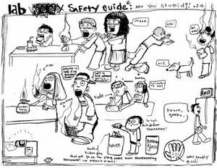
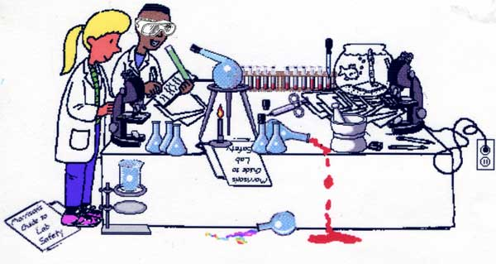
Right or wrong? Discuss in pairs

Slide 14
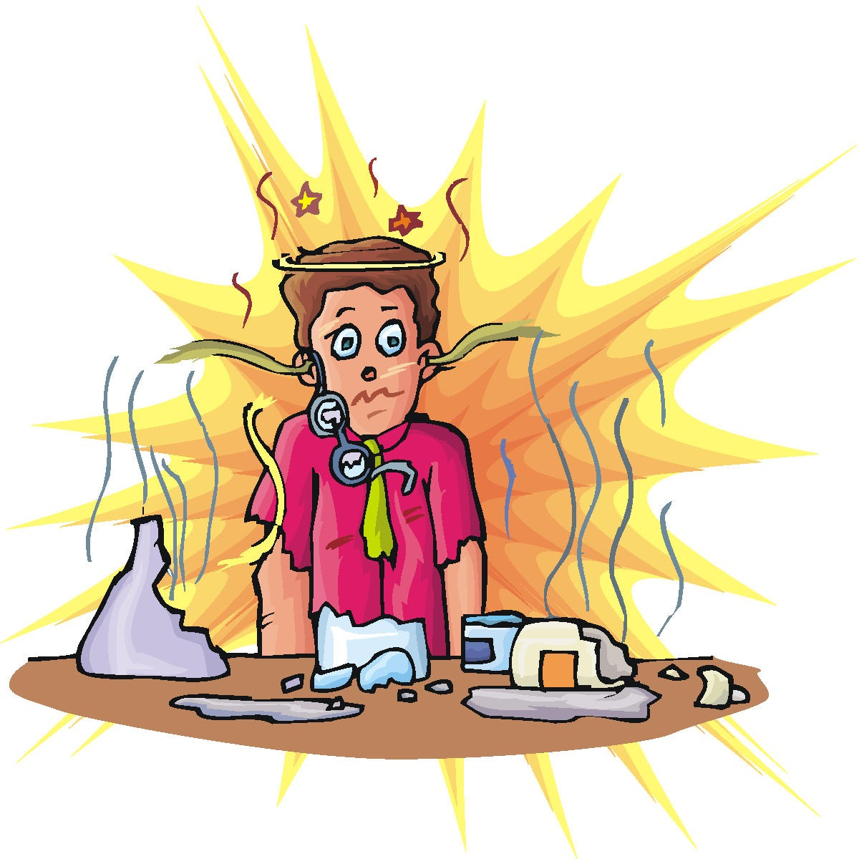
If you don’t know lab rules

